Slide 1
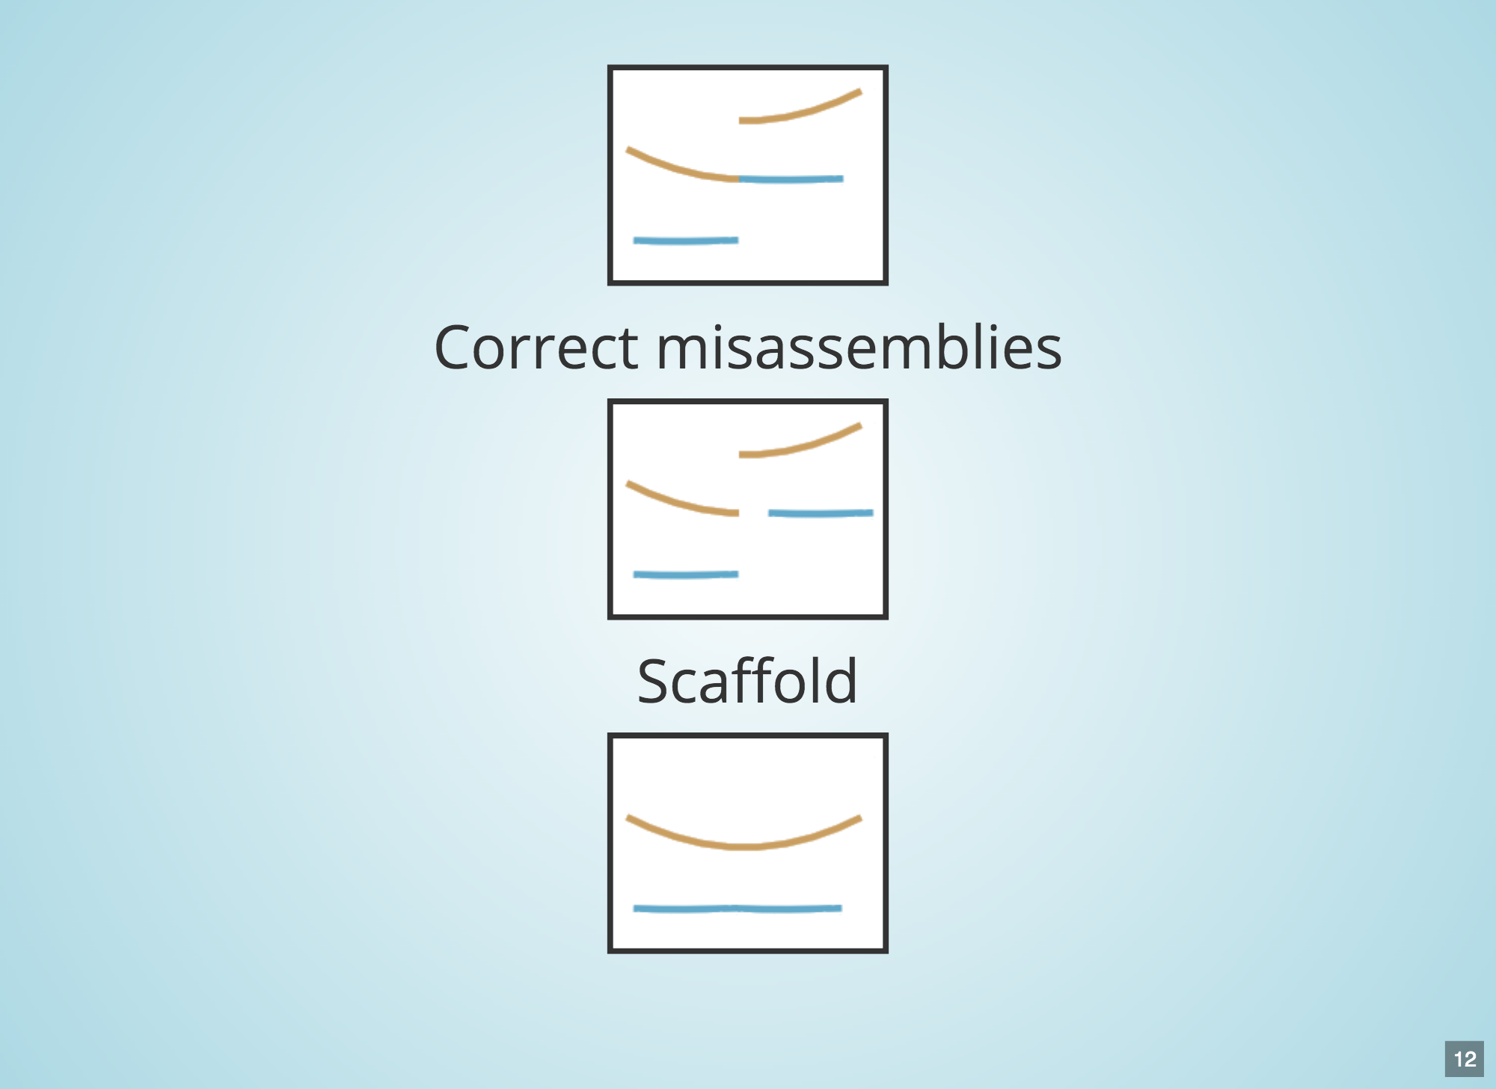










Assembly
Correction
Scaffolding
Gap-filling
Polishing
technology
Sealer
Input
Short
Linked
Sequencing reads
+
Long
NGS
e.g. Illumina/MGI
Genome
ALL DRAFT ASSEMBLIES SUPPORTED
SMS
e.g. ONT/PacBio
Notes:
LINKS 2.0 in development

